Slide 1

Clustering Assignment-Part I K-Means + Hierarchical
Submitted By : Snigdha Chakraborty

Slide 2
Background
HELP International is an international humanitarian NGO that is committed to fighting poverty and providing the people of backward countries with basic amenities and relief during the time of disasters and natural calamities. It runs a lot of operational projects from time to time along with advocacy drives to raise awareness as well as for funding purposes
After the recent funding programs, they have been able to raise around $ 10 million. Now the CEO of the NGO needs to decide how to use this money strategically and effectively. The significant issues that come while making this decision are mostly related to choosing the countries that are in the direst need of aid

Slide 3
Problem Statement
To categorize the countries using some socio-economic and health factors that determine the overall development of the country
To suggest the countries which the CEO needs to focus on the most
To report back at least 5 countries which are in direst need of aid from the analysis work that we performed

Slide 4
Technical Approach
Data Understanding and Data Cleaning
EDA
Univariate Analysis
Bivariate Analysis
Data Preparation
Outlier Treatment
Data Scaling
Hopkins Statistics (to check if the dataset is good enough for a cluster analysis)
Clustering
K-Means Clustering
Silhouette Score
Elbow Curve/SSD
Hierarchical clustering
Single Linkage
Complete Linkage
Cluster Profiling
Final Analysis and Outcome

Slide 5
EDA Summary
Univariate Analysis shown most of the African countries has
Lowest
Life Expectancy, GDP, Per Capita Income, Health, Imports, Exports
Highest
Child Mortality Rate, Inflation
Heat Map analysis:-
child_mortality and life_expentency are highly correlated with correlation of -0.89
child_mortality and total_fertility are highly correlated with correlation of 0.85
imports and exports are highly correlated with correlation of 0.99
life_expentency and total_fertility are highly correlated with correlation of -0.76

Slide 6
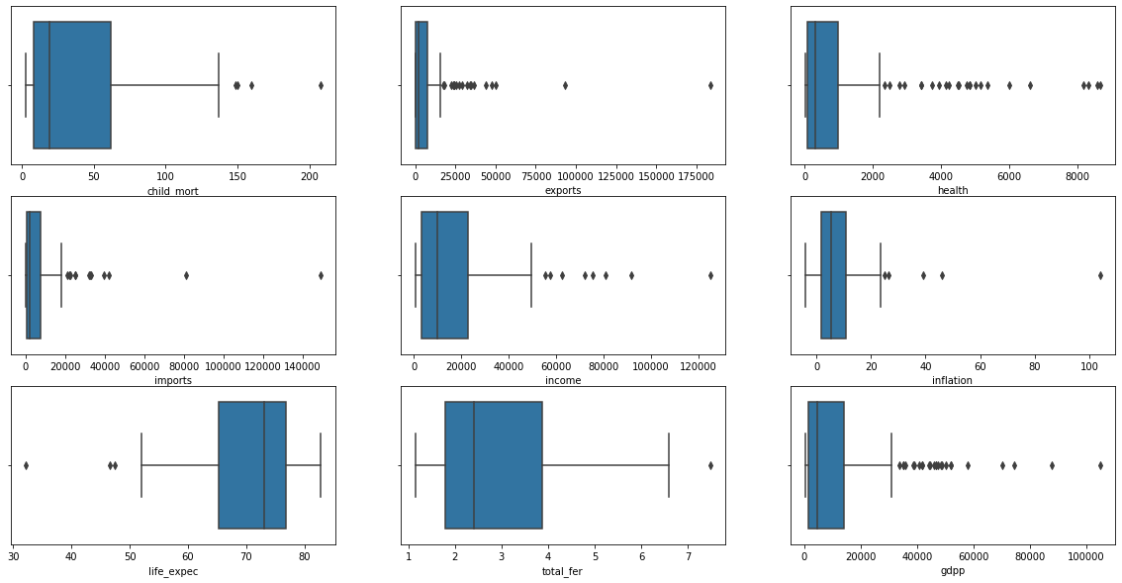
Outlier Summary & Visualization
We found outliers in almost all the features esp. in GDP and Health
As we have only 167 countries, removing these outliers would shrink the shape of data and the under-developed countries which are in actual dire need may not contribute to the dataset
The outliers were treated using soft capping of 1 – 99th percentile

Slide 7
Hopkins Statistics
A 'Hopkins Statistic' value close to 1 tends to indicate the data is highly clustered, random data will tend to result in values around 0.5, and uniformly distributed data will tend to result in values close to 0
Hopkins Statistic of standardized scaled date came out to be 0.89
Hopkins Statistic over 0.70 is a good score that indicated that the data is good for cluster analysis.

Slide 8
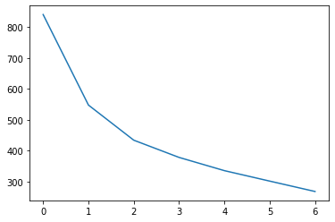
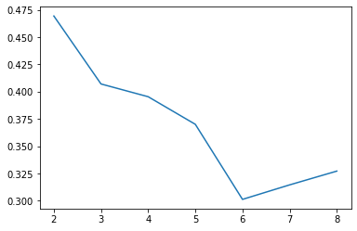
K-Means Clustering
K-means is a centroid-based algorithm, or a distance-based algorithm, where we calculate the distances to assign a point to a cluster
As per elbow curve and silhouette score analysis 3 turned out be the optimal cluster
Also as per global economic factors dividing cluster into 3 seems logical and Final model was build using 3 clusters
Elbow/SSD curve
Silhouette Score

Slide 9
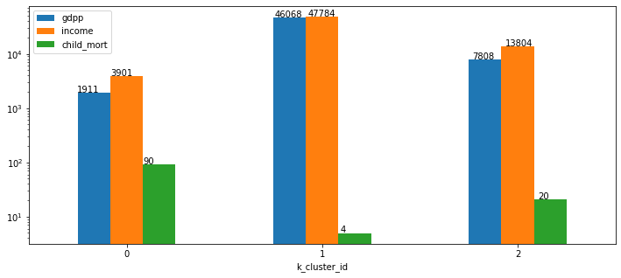
Cluster Summary (K-Means)
Based on descriptive statistics 3 clusters are identified as-
Cluster 0 -> Under-Developed Countries
Cluster 1 -> Developed Countries
Cluster 2 -> Developing Countries
Cluster 0 has low GDP, low income and highest child mortality rate
All these factors made these cluster best candidate for financial aid from HELP NGO
We also observed cluster 0 comprises of 29% of total data

Slide 10
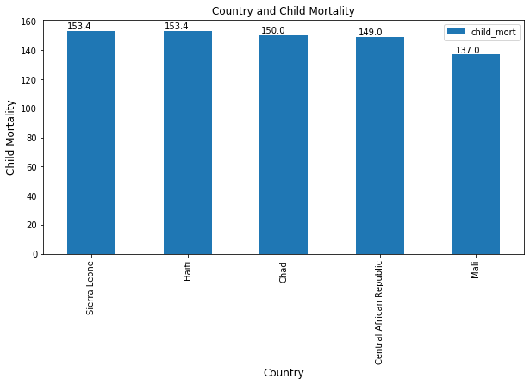
Cluster Profiling (K-Means)
Top 5 under-developed countries from cluster 0 in dire need of aid are
0 Sierra Leone
1 Haiti
2 Chad
3 Central African Republic
4 Mali
Visualization of Country Vs Child Mortality Rate, GDP, Income:-

Slide 11
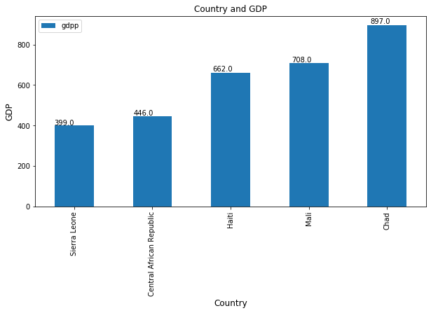
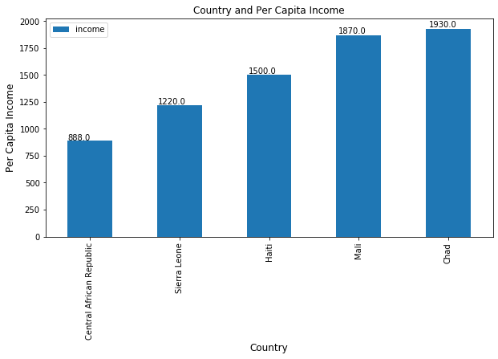
Cluster Profiling (K-Means) – contd..
Country Vs GDP
Country Vs Income

Slide 12
Hierarchical Clustering
Hierarchical cluster analysis is an unsupervised clustering algorithm which seeks to build a hierarchy of clusters
Agglomerative – “Bottom-Up” Approach
Divisive – “Top-Down” Approach
Linkage – It determines the distance between sets of observations
Single Linkage - the shortest distance between two points in each cluster
Complete Linkage - the longest distance between two points in each cluster

Slide 13
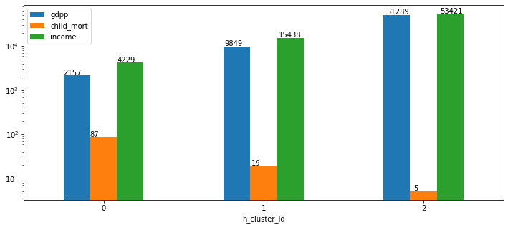
Cluster Summary (Hierarchical)
Based on descriptive statistics 3 clusters are identified as-
Cluster 0 -> Under-Developed Countries
Cluster 1 -> Developing Countries
Cluster 2 -> Developed Countries
Cluster 0 has low GDP, low income and highest child mortality rate
All these factors made these cluster best candidate for financial aid from HELP NGO
We also observed cluster 0 comprises of 50% of total data

Slide 14
Cluster Profiling (Hierarchical)
We observed that Hierarchical clustering gave same set of countries as K-Means
Top 5 under-developed countries from cluster 0 in dire need of aid are
0 Sierra Leone
1 Haiti
2 Chad
3 Central African Republic
4 Mali

Slide 15
K-Means Over Hierarchical
After analyzing both K-means and Hierarchical clustering we observed clusters formed are identical
K-Means clustering requires prior knowledge of K i.e. no. of initial clusters. Where as, in hierarchical we can cut the dendrogram at appropriate level to get a better initial cluster
The time complexity of K Means is linear = O(n) while that of hierarchical clustering is quadratic = O(n2)
Considering the time complexity and dataset given we will proceed with the clusters formed by K-means and based on the information provided by the final clusters we will deduce the final list of countries which need aid

Slide 16
Final Analysis
We concluded top 5 countries from final cluster (under-developed countries) based on GDP, Child Mortality Rate and Per Capita Income
Sierra Leone
Haiti
Chad
Central African Republic
Mali
Below is the ordered we filtered the list of country names:
Lowest GDP
Lowest Income
Highest Child Mortality Rate

Slide 17
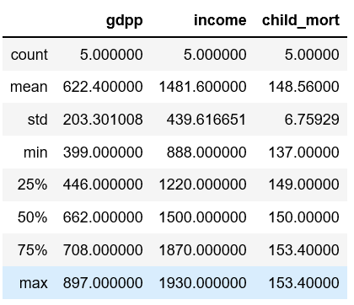
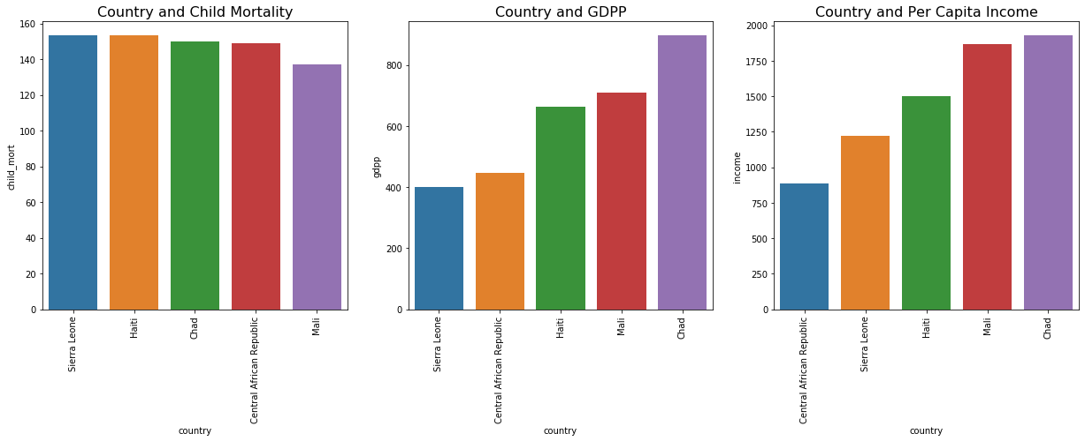
Final Statistics of Recommended Countries

